Slide 1

NYC Crime Analysis
By: Andres Chaves,
Anita Guo

Slide 2

The Data
We used the NYPD Arrest Data (Year to Date) . We found it in NYC OpenData. The data set is a breakdown of every arrest arrested in NYC by the NYPD during the current year.
168k arrests
Geographical data
We appended zip code level Medium income.

Slide 3
Disparity in Marijuana Arrest in NYC
If you live in New York City, most likely you have come to realize how ubiquitous the consumption of marijuana has become. People smoke across the city in all types of neighborhoods. People smoke walking their dogs, outside bars and playing in the park.
In this analysis, I want to look at 2019 arrest data. Particularly I will look into marijuana related arrests and compare the frequency across different zip codes.

Slide 4
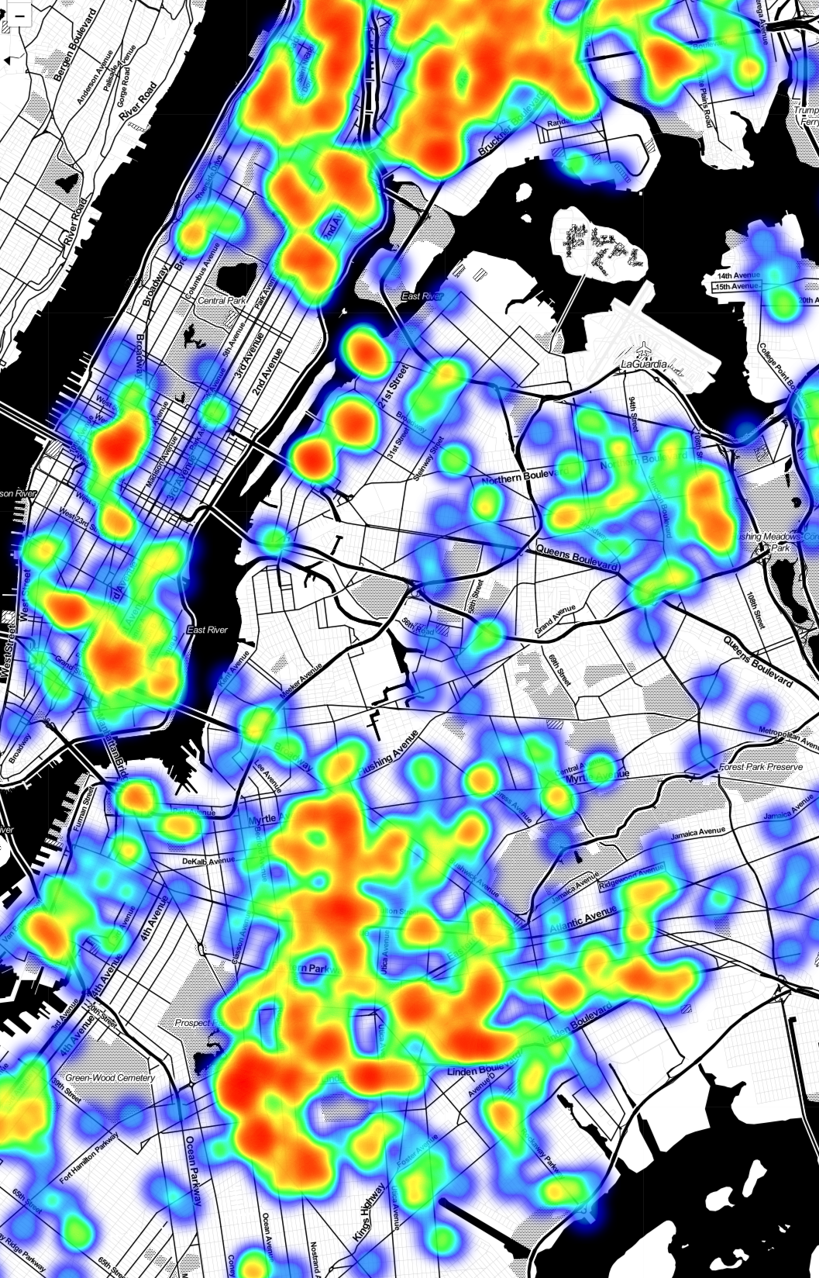
Looked at Marijuana Arrests in NYC

Slide 5
1 .Segmenting Data by Neighborhoods
Grouped zip codes in neighborhoods and found the average of medium income.
High income neighborhoods: Gramercy Park and Murray Hill , Greenpoint, Village and Soho, Lower Manhattan, Upper East and West Side, Northeast Queens, Northwest Brooklyn, South Shore, Southeast Queens (average median income > 67410)
Low income neighborhoods: East NY, Moth Heaven and Hunts Point, Inwood and Washington Heights, Southern Brooklyn, Highbridge and Morrisania (average median income < 40565)
Ho = The number of marijuana arrests is not correlated with neighborhoods
Ha= The number of marijuana arrests is different for different income neighborhoods

Slide 6
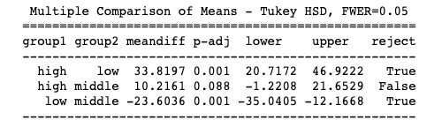
Multiple Comparison Test
We found a significant difference between the high and low income and low and middle income groups.

Slide 7
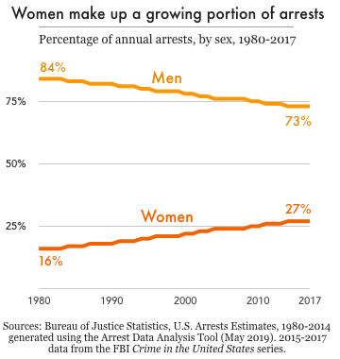
2. Gender Disparity
The gender of the perpetrator was included in the data set. Out of 167965 incidents, 18% where perpetrated by women.
We attempted to compare this to the nation wide 27% . We ran a one sample t-test and got a p-value of 0 .
Ho = Female arrest in NYC are correlated with nationwide arrests
Ha= Female arrest in NYC are higher than the nation.
This suggest there is a mistake in the analysis.

Slide 8
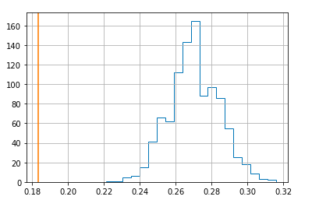
Simulation
Assuming that the data is normally distributed, I conducted 1000 simulations.
Indeed the 18% female rate is many standard deviations away from the mean I found in the literature.

Slide 9
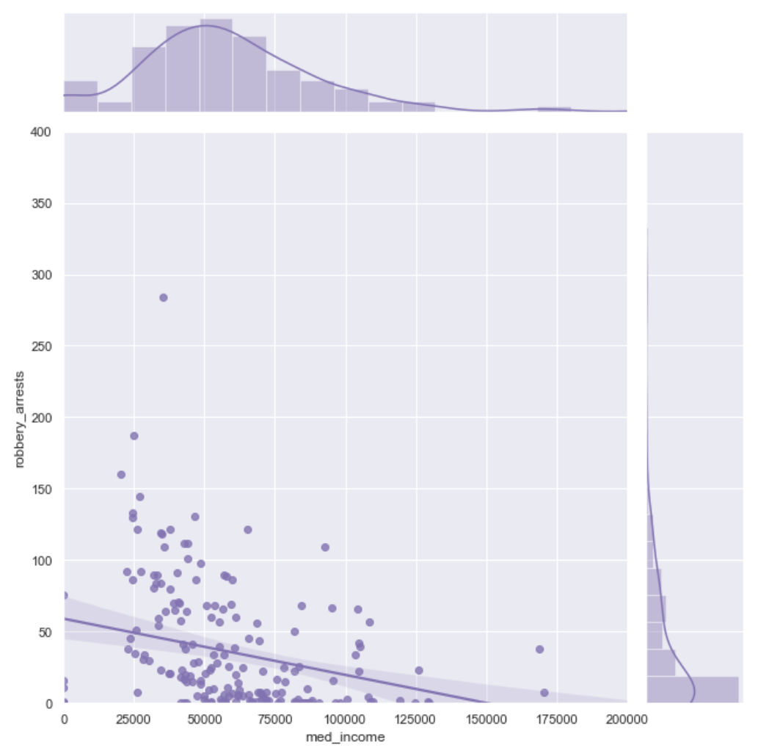

Medium Income vs. Robbery Correlation
Direction: negative
Form: linear relationship
Strength: weak
r = -0.29 indicates that there is a negative, linear relationship of weak strength between these 2 variables
Most robberies take place where medium income is > 50k and < 65k
The relationship is considered strong when their r value is > 0.7

Slide 10
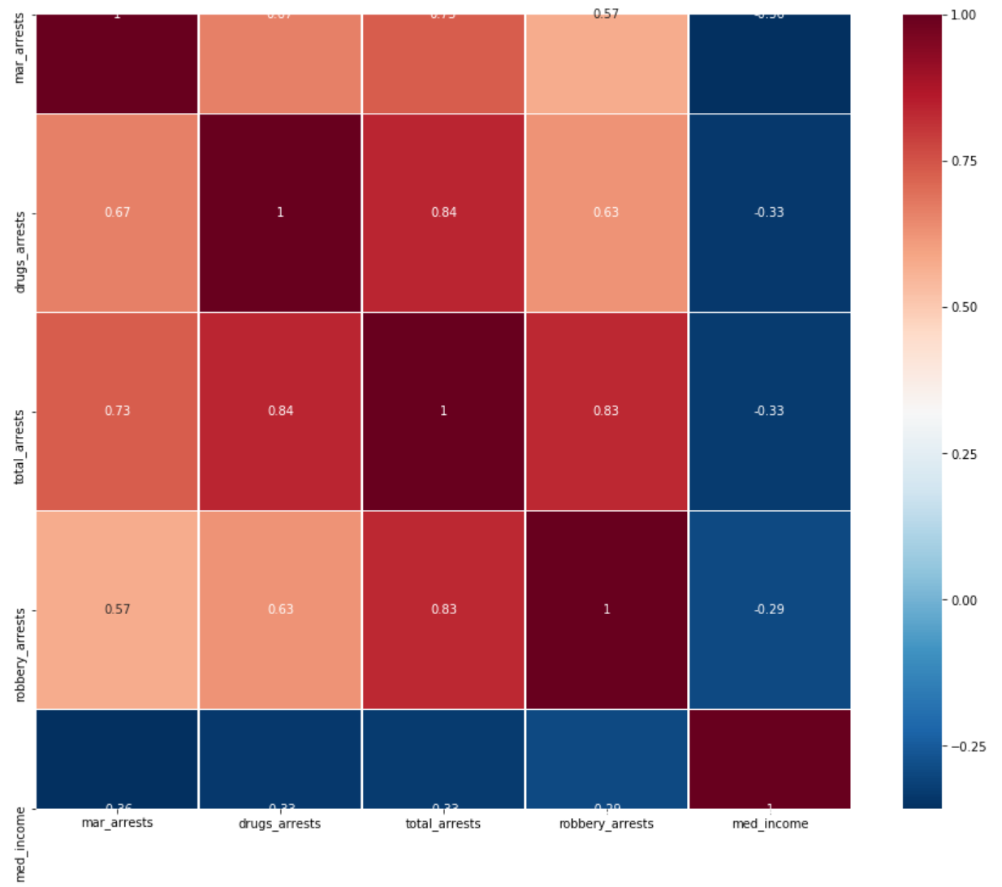
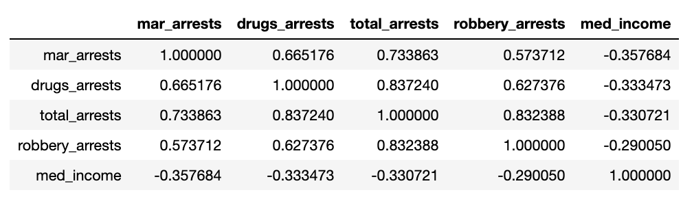
Medium Income vs. Crime Correlation

Slide 11
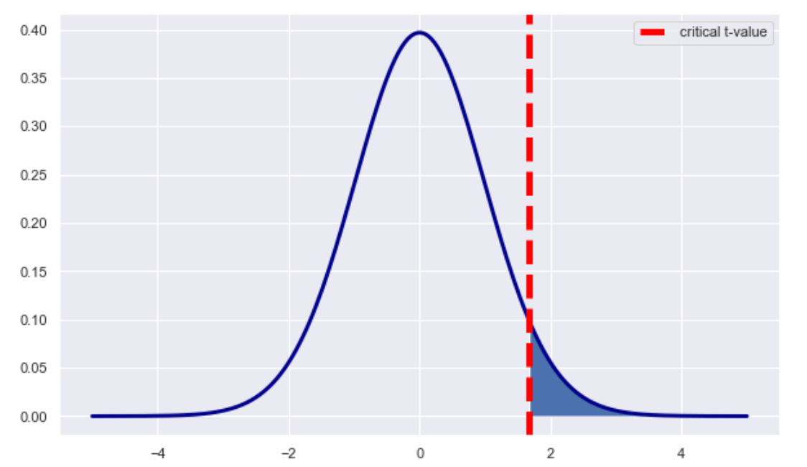
Medium Income vs. Robbery Hypothesis test
H0: Medium income has no relationship with robberies rates
mu = 36.14 (avg #of robbery across all income neighborhood)
H1: higher med income areas have lowers robberies rate.
mu < 36.14 (avg #of robbery of higher medium income > 70000)
t-critical = 1.673
t-value for sample = -6.89
p-value = 0.0
Sample: higher med income neighborhoods and robbery rates
56 observations, mean = 15.0
standard deviation = 22.96 ,
mu (36.14) - x bar(15) = 21.14
As the difference between the sample data and the null hypothesis increases, the absolute value of the t-value increases

